Slide 1
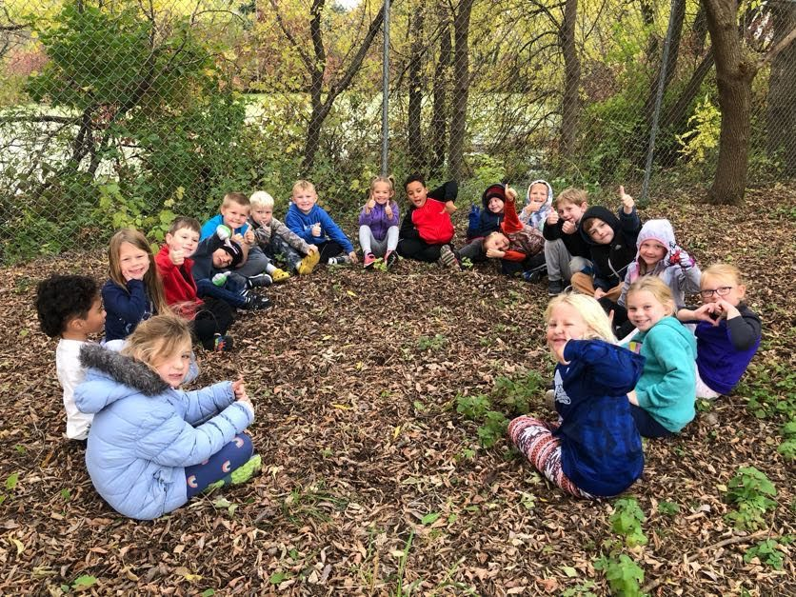
The Power of Outdoor Learning: Impacts on Early Childhood Development and Educator Well-Being
Arianna E. Pikus, Ph.D
Institute for Early Childhood Development & Education

Slide 2
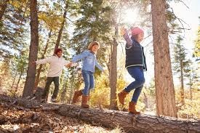
Benefits of Nature
Physical Development
Improves coordination, balance, and agility
Health benefits
Socio-emotional Development
Socialization skills
Peer play skills
Cognitive Development
Problem solving
Early literacy
Motivation to learn
(Brussoni et al., 2017; Burgess & Ernst, 2020; Eick, 2011; Fjortoft, 2001; McCurdy et al., 2010; Pikus et al., 2025)

Slide 3
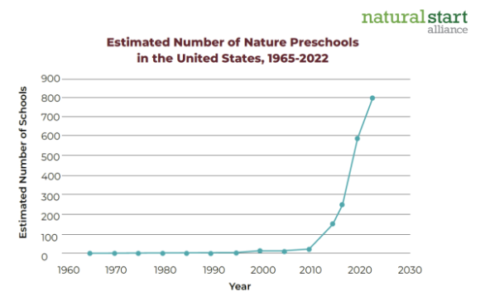
Background
Nature-based education is growing in the U.S.
Current estimation:
800 programs
25,000 children
48 states

Slide 4
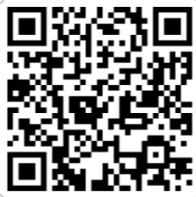
Investigating Nature-based Preschoolers Gains in Early Literacy and Select Executive Function Skills
Arianna E. Pikus, Lori E. Skibbe, Rachel A. Larimore, & David Sobel (2025)
Notes:
Compared nature-based preschoolers to children who attend non-nature schools
Our overarching aim is to investigate how preschoolers are being prepared for kindergarten in a nature-based program compared to a non-nature preschool.

Slide 5
Research Aims
Investigate the amount of time each type of preschool spends outdoors during a typical day.
Determine if children who attend a nature-based preschool develop early literacy and executive function skills at a similar rate as children who attend a non-nature preschool.

Slide 6
Methods

Slide 7
Classroom Observations
Nature-based Preschool
Non-Nature Preschool
3 Classrooms ​
Half-day sessions​
M = 175.11 minutes, SD = 4.39
3 Classrooms ​
Half-day sessions​
M = 164.07 minutes, SD = 2.09
Notes:
Both of these school had a 5-star rating in Michigan’s Quality Rating Improvement System ​
The goal of the classroom observations was to note the types of activities that occurred in the nature-based and non-nature classrooms that could support early literacy and EF development in children.

Slide 8
Child Demographics
Nature-based Preschool
Non-Nature Preschool
82 Children (55 boys)​
Average age ~ 42.5 months​
Mothers’ Education​
46.3% Bachelor’s Degree​
32.9% Graduate/Professional Degree
58 Children (27 boys)​
Average age ~ 45 months​
Mothers’ Education​
31% Bachelor’s Degree​
48.3% Graduate/Professional Degree
Notes:
No statistical differences in materal eduation or income, however the nature preschool had more boys than the non-nature preschool and children at the non-nature preschool were on average 2 months older. Demographic characteristics that differed significantly by location was used as a covariate in the quantitative analysis.

Slide 9
Assessments
Early Literacy
Executive Function
Phonological Awareness
Test of Preschool Early Literacy Skills (TOPEL: Lonigan et al., 2007)
Letter Name Knowledge
Quick Letter Name Knowledge (Q-LNK; Tortorelli et al., 2017)
Letter Sound Knowledge
Letter Sound Knowledge (LSK; Piasta et al., 2016)
Inhibitory Control
NIH Toolbox: Flanker Inhibitory Control and Attention Test (Weintraub et al., 2013)
Working Memory
NIH Toolbox: Picture Sequence Memory Test (Weintraub et al., 2013)
Behavioral Self-Regulation
Head-Toes-Knees-Shoulders (HTKS; McClelland et al., 2014)

Slide 10
Results

Slide 11
Findings
Children at the nature-based preschool spent on average, 90 more minutes outside daily (t(2.19) = -4.30, p < .05)
Early Literacy
Phonological Awareness​
F (1, 95) = 1.49, p = .23​
Letter Name​
F (1, 103) = .001, p = .98​
Letter Sound​
F (1, 102) = .10, p = .68
Executive Function
Working Memory
F (1, 97) = .12, p = .73
Inhibitory Control
F (1, 87) = 2.44, p = .12
Behavioral Self-Regulation
F (1, 88) = 13.67, p < .001

Slide 12
Conclusions
Both preschools supported children’s development in early literacy and select executive function skills
Children who attended the non-nature preschool showed greater change in scores in behavioral self-regulation
Possible explanations
Non-nature classrooms were more likely to provide opportunities for children to practice self-regulation skills
Blended approach with a mix of unstructured nature play and structured instructional time (Ernst et al., 2022)
Unstructured play predicts behavioral self-regulation 2 years later (Colliver et al., 2022)
Notes:
This results was surprising.
It is possible that the structure of non-nature programs provides more opportunities for children to practice behavioral self-regulation skills. For example, at group meetings, children were encouraged to “sit still” and “use an inside voice.” Whereas children at the nature-based preschool spent the majority of class time outdoors where they were allowed to shout and run around, instead of practicing “indoor voices” as in the non-nature classrooms.
It is possible that moving forward, nature-based preschools should take a “both/and” approach where there is a mix of unstructured nature play and structured instructional time. Recent empirical evidence has shown that children who attend nature preschool programs which take a more blended approach, where a program focuses on early academic skills but incorporates more unstructured nature play than a more traditional program, have significant positive effect on children’s executive function skills compared to children who attend a non-nature program (Ernst et al., 2022).
For example, a recent longitudinal study found that the amount of time children engaged in unstructured active play significantly predicted their behavioral self-regulation skills two years later (Colliver et al., 2022). While the current study found less growth in behavioral self-regulation for children who attended the nature-based preschool, it is possible that the benefits of unstructured play on self-regulation take longer to manifest and future work should examine the longitudinal impact of more time in nature for children.

Slide 13
Quasi-experimental Examination of Nature-based Programming in Kindergarten and First Grade Classrooms within One School District
Arianna E. Pikus & Lori E. Skibbe (under review)

Slide 14
Research Questions
Are children who attend a nature-based kindergarten developing literacy and numeracy skills at the same rate as children in more traditional classrooms?
Are children who attend a nature-based first grade developing literacy and numeracy skills at the same rate as children in more traditional classrooms?

Slide 15
Methods

Slide 16
Participants - Kindergarten
Nature
134 children
51.5% = Male
64.2% = White
Missing data on 33.6%
100% = Native English Speakers
49.6% = FRL
Non-Nature
51 children
55.9% = Male
84.3% = White
Missing data on 2%
98% = Native English Speakers
35.3% = FRL
Notes:
185 K students between 2017 – 2018 & 2018 – 2019
2017 – Nature = 4 classrooms; Non nature = 2 classrooms
2018 – All classrooms moved to nature; Did not include the ones newly transitioned to nature; 3 more classrooms

Slide 17
Participants – First Grade
Nature
155 children
53.5% = Male
93.5% = White
Missing data on 3.2%
100% = Native English Speakers
46.5% = FRL
Non-Nature
111 children
52.3% = Male
87.4% = White
Missing data on 2.7%
98.2% = Native English Speakers
36.9% = FRL
Notes:
266 students total
Two of the three elementary schools in the district had nature-based first grade classrooms, while the other elementary school utilized a traditional curriculum. Over both school years, there were seven nature-based first grade classrooms and five traditional first grade classrooms.

Slide 18
Measures – Kindergarten
Aimsweb Plus Assessment System (Pearson, 2017)
Literacy
Letter Naming Fluency
Letter Word Sound Fluency
Auditory Vocabulary
Numeracy
Number Naming Fluency
Quantity Total Fluency
Concepts and Applications
Notes:
Student assessment scores in the school district utilized the Aimsweb Plus (Pearson, 2017) assessment system to measure performance and growth in all its students in K-8 classrooms. For kindergarten and first grade, teachers gave assessments and recorded children’s answers with paper and pencil and later entered them into the Aimsweb Plus data management system.
Letter Naming Fluency. For the Letter Naming Fluency measure, children were presented with letters and asked to name as many as possible in one minute. Presented letters include both upper case and lower case letter. Children received one point for every letter correctly named. Alternative form reliability was 0.78. This measure was given to kindergarteners.
Letter Word Sound Fluency. The Letter Word Sounds Fluency measure assessed children’s ability to produce the sounds of letters and combine those sounds into syllables and words. Children were asked to say the sounds of the letters, syllables, and words presented to them. Children have one minute to name as many letter/word sounds as they can and received one point for each correct answer. Each form contains 45 letters and 10 three-letter words. Alternative form reliability was 0.87. Only kindergarteners were assessed on this skill.
Auditory Vocabulary. The Auditory Vocabulary measure presented children with four pictures and asked children to pick the one that represented the orally presented target word. Children are asked 25 items and receive one point for each correctly answered item (possible scores range from 0 – 25). Cronbach’s alpha was 0.82.
Number Naming Fluency. The Number Naming Fluency measure (NNF; Pearson, 2017) asked children to point to and name a presented number. Children are given one minute to identify as many numbers presented as possible. Children receive on point for each correctly named number. Alternative form reliability was 0.90. Only kindergarteners received this assessment.
Quantity Total Fluency. The Quantity Total Fluency measure (QTF; Pearson, 2017) asked children to state the total number of dots in a presented box or pair of boxes. Children are asked to give as many correct answers as possible in one minute. For each correct answer, children earned one point. Alternative form reliability was 0.80. Kindergarten students were assessed on this measure.
Concepts and Applications. The Concepts and Applications measure (CA; Pearson, 2017) asks children to solve one-step and two-step math word problems. Children are read each item, and then asked to state the correct answer using the corresponding visual stimulus to solve the problem. Children are asked 25 items and receive one point for each item correctly answered (possible scores range from 0-25). Cronbach’s alpha was 0.83. Both kindergarteners and first graders received this measure.

Slide 19
Measures – First Grade
Aimsweb Plus Assessment System (Pearson, 2017)
Literacy
Oral Reading Fluency
Word Reading Fluency
Auditory Vocabulary
Numeracy
Math Facts Fluency – 1 Digit
Number Comparison Fluency
Concepts and Applications
Notes:
Student assessment scores in the school district utilized the Aimsweb Plus (Pearson, 2017) assessment system to measure performance and growth in all its students in K-8 classrooms. For kindergarten and first grade, teachers gave assessments and recorded children’s answers with paper and pencil and later entered them into the Aimsweb Plus data management system.
Oral Reading Fluency. For the Oral Reading Fluency measure, children are asked to read two stories--each story is read for one minute. The number of words read correctly in each story is averaged together to create a child’s Oral Reading Fluency score. Only first graders were assessed on this skill.
Word Reading Fluency. For the Word Reading Fluency measure, children are asked to read words aloud from a list. Children have one minute to read as many words as they can and receive one point for each correct answer. Each form contains two pages of word lists (99 words total). This measure was given to first graders.
Auditory Vocabulary. The Auditory Vocabulary measure presented children with four pictures and asked children to pick the one that represented the orally presented target word. Children are asked 25 items and receive one point for each correctly answered item (possible scores range from 0 – 25). Cronbach’s alpha was 0.82.
Math Facts Fluency – 1 Digit. For the Math Facts Fluency measure, children are asked to solve addition and subtraction problems involving numbers 0 – 10. Each form contains 40 items and children are given one minute to answer as many items as possible. Children received one point for every correct answer. This measure was given to first graders.
Number Comparison Fluency. The Number Comparison Fluency measure evaluates children’s ability to compare two numbers. Children are presented with two numbers and asked to point to and name the larger number of the pair. Children have one minute to answer as many items as possible. Children received one point for each correctly answered item. Each form contains 50 items. Only first graders were assessed on this skill.
Concepts and Applications. The Concepts and Applications measure (CA; Pearson, 2017) asks children to solve one-step and two-step math word problems. Children are read each item, and then asked to state the correct answer using the corresponding visual stimulus to solve the problem. Children are asked 25 items and receive one point for each item correctly answered (possible scores range from 0-25). Cronbach’s alpha was 0.83. Both kindergarteners and first graders received this measure.

Slide 20
Results

Slide 21
Kindergarten – Literacy
F(1, 179) = 1.83, p = .18
F(1, 179) = 1.73, p = .19
F(1, 177) = .32, p = .57
Notes:
Fall test scores were a significant predictor of spring test scores

Slide 22
Kindergarten – Numeracy
F(1, 181) = 1.53, p = .22
F(1, 181) = .24, p = .62
F(1, 180) = .48, p = .49
Notes:
Fall test scores were a significant predictor of spring test scores

Slide 23
First Grade – Literacy
F(1, 236) = 1.62, p = .21
F(1, 187) = .23, p = .63
F(1, 187) = .88, p = .35
Notes:
Fall test scores were a significant predictor of spring test scores

Slide 24
First Grade – Numeracy
F(1, 234) = .002, p = .88
F(1, 234) = .32, p = .57
F(1, 234) = 4.08, p = .05
Notes:
Fall test scores were a significant predictor of spring test scores

Slide 25
Conclusions
Children who attended nature and non-nature classrooms showed similar growth in literacy skills
Children who attended nature and non-nature classrooms showed similar growth in many numeracy skills
However, children in non-nature classrooms had significantly greater gains in solving math word problems
Many elementary aged children struggle with math word problems (Vessonen, et al., 2024)
Nature teachers may need to provide more explicit instruction in this area

Slide 26
Examining the Relationship Between Time Outside and Teachers’ Reported Well-Being
Arianna E. Pikus, Eleanor Su-Keene, & Kristen Shumbera (under review)
Notes:
Very Exploratory Study

Slide 27
Background
Teacher well-being is related to teacher effectiveness, student outcomes (Duckworth et al., 2009), teacher satisfaction and positive emotions (Bullough & Pinnegar, 2009), and negatively related to burnout and stress (Buric et al., 2019).
Time outside has been shown to contribute to one’s personal health, mental health, and overall well-being (Mintz et al., 2021; Russell et al., 2013).
However, the role of being outside in nature has yet to be studied on teachers’ well-being.

Slide 28
Research Questions
On average, how much time do teachers spend outdoors during work hours and non-work hours in a typical week?
To what degree does time outdoors predict teachers’ well-being?

Slide 29
Methods

Slide 30
Participants
206 public school K-12 teachers from across Texas
Majority of the sample identified as:
Female (n = 177)
White (n = 176)
Years of experience ranged from 0 - 38 years (M = 9.86 years, SD = 7.59)
Classroom :
Elementary school (n = 104), Middle school (n = 66), High school (n = 36)
Rural (n = 56), suburban (n = 80), urban (n = 70)
FRL: M = 64.8, SD = 31 (Range: 3 - 100)

Slide 31
Measures
Demographics
Well-being
The Flourishing Scale (Diener et al., 2010)
Stress
Perceived Stress Scale (PSS; Cohen et al., 1983)
Time Outdoors
When weather allows, how many minutes during school do you spend outside in a typical week?
When weather allows, how many minutes do you spend outside during non-school hours in a typical week (including weekends)?

Slide 32
Results

Slide 33
Time Outside During a Typical Week (School Hours)
On average, teachers spent 38.10 (SD = 63.60) minutes during a typical week
Range: 0 - 450
34% of teacher reported spending 0 minutes outside during a typical week
57% of teachers reported spending < 30 minutes outside during a typical week
Time outdoors included:
Assigned tasks (e.g., supervising recess or pick-up duty) - 43%
Personal Time - 19%

Slide 34
Time Outside During a Typical Week (Non-School Hours)
On average, teachers spent 148.75 (SD = 201.69) minutes during non-school hours in a typical week
Range: 0 - 1200
Time outdoors included:
Exercising - 60%
Yard work - 12%
Walking/playing with pet - 7%
Enjoying time outdoors - 17%

Slide 35
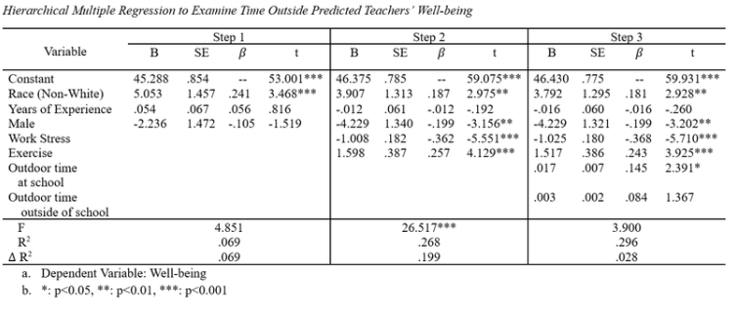
Time Outside Predicts Well-being

Slide 36
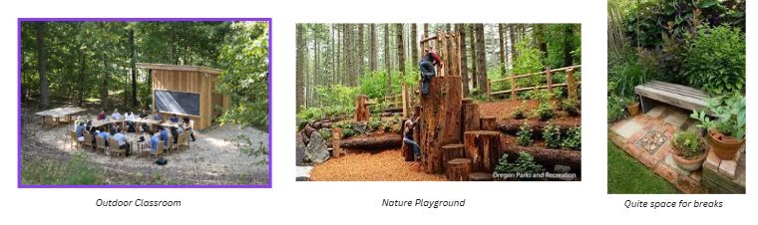
Conclusions
Exploratory study
Future work should examine how time outside mediates the relationship between teachers’ stress and well-being
Intentional design and/or schedule decisions to incorporate more time outside

Slide 37
Questions? Thank you! Pikusari@tamu.edu

